Slide 1
NCDF Data Lake Architecture Views
Nov 24
Chuck Turnitsa
NCDF Data Lake Architecture TT Lead
Notes:
vincenzo.desortis@devops.ncia.nato.int

Slide 2
Agenda
1. Review our list of open items left from the DM-CaT meeting
2. Review of the different Service Views (NAF) to be completed
3. Review of which of our Services will be described by Views (from our high level NCIA Service walk through...)
4. State of existing Architectural Diagrams (from earlier Architecture)
Notes:
NST – NATO Software Tools
6 Nations
Invite Vincenzo – to discuss an experiment – at next CWIX – test NCDF data lake user, security
Use Case of NCDF Data Lake
Experience with Tactical (FMN) domain data
From Data Lake to Tactical – possible with filters, transformers
Security people – DCS – worried about Tactical specifically
Each nation will have their own DCS layer, providing nation-centric security
US is moving fast with DCS
UK is uncomfortable with speed of US’ development
For our Federation/Architecture – how will users be authenticated across federation
Use of Trust, and Chain of Trust
Experiment – Use a NATO system, to try to make a NCDF request, where security is involved in the evaluation of the request
Note( DCS testing with US is with CentCOM – using Joint Interoperability Data Centricity)
Lookup: CENTRIX

Slide 3
Open Items after DMCaT working Session
Management
Management software services
Management business rules
When do data elements become ‘stale’
What about redundant BSOs for the same entity?
If removed from one Data Lake, what if it exists in a separate Federated Data Lake?
Etc.
Likely not included in CWIX 2022. Open for discussion.
Metadata
Only as provided from BSO?
NATO Metadata STANAG
Metadata producing service? Open for discussion.
Objects other than BSOs?
Where is the limit? Do they get a SRM wrapper? Open for discussion.
Transformation
Will any Transformation services be made available? Open for discussion.

Slide 4
List of Service views planned
S2 – Service Structure – it shows how the various software services (APIs) can be aggregated or composed to fulfill an operational service (use case)
S3 – Service Interfaces – gives details on the interfaces (input, output) to services – including data requirements for the API, etc.
S4 – Service Functions – gives a functional breakdown of what a service does.
S5 – Service Status – gives a list of the states that the service can be in (waiting, moving data, processing, requesting resource, submitting, etc etc) – this may or may not prove useful for our services...
S6 – Service Interactions – shows an interaction diagram of how the services handle a user’s request – timing chart
S1 – Service Taxonomy – a catalog of all the Service Views...

Slide 5
Data Lake services
Each “service” (software service) will get the following: S2, S3, S4, S6 (S5 is optionally provided)
One complete taxonomy view in an S1 (done last)
The broad categories of the services (each of these categories will be described by a C5 view):
Search/Retrieve
Produce
Publish/Subscribe
Produce involves methods for systems to provide information to the NCDF Data Lake
Publish/Subscribe is a way for a retriever to subscribe to updates from a Producer

Slide 6
Service Views – S2

Slide 7
Service Views – S3

Slide 8
Service Views – S4

Slide 9
Service Views – S5 (tentative)

Slide 10
Service Views – S6

Slide 11
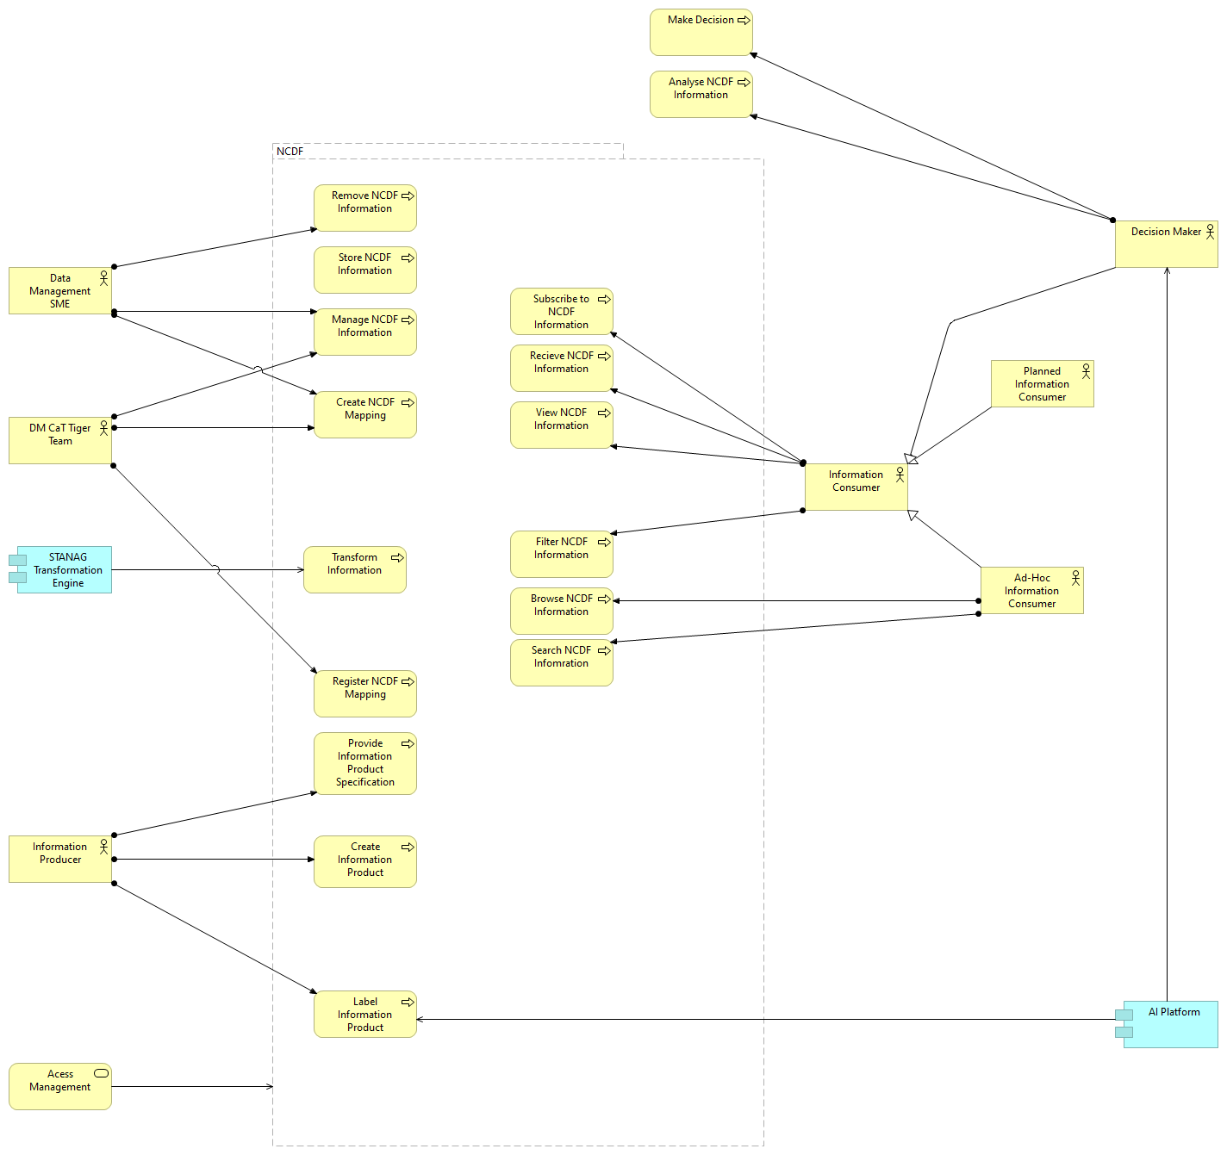
Do these already exist?
Use Case diagram showing the functional “services” exists from the older NCDF Data Lake architecture...
S2-5
S2-5
S2-5
S2-4
S2-5

Slide 12
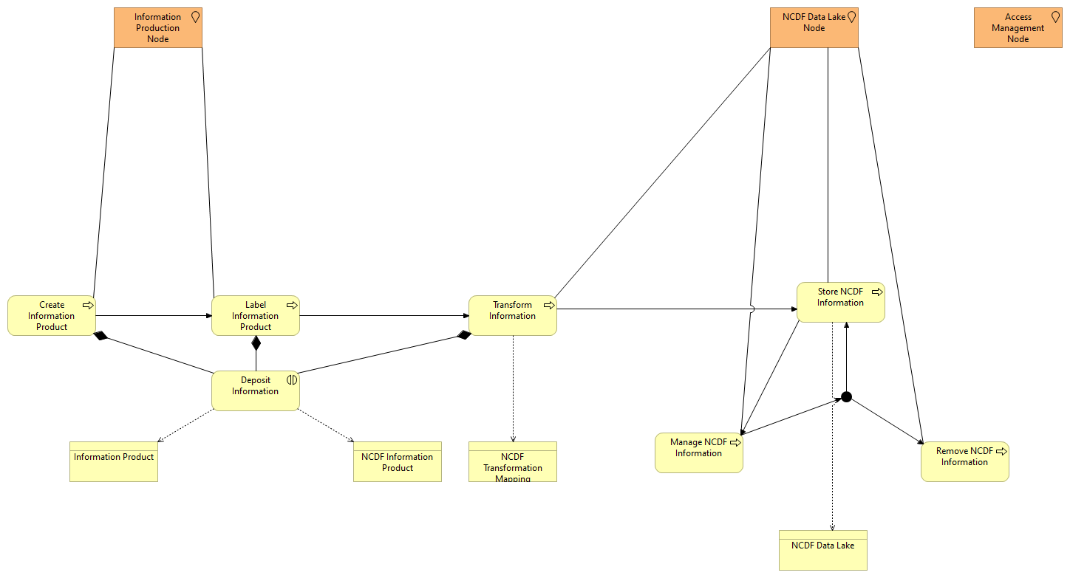
Example – Data Lake Storage
Some of these exist – but not based on a particular NAF view – more of a generic Object/Activity diagram (shows actions – in yellow, and physical assets – in orange)

